Slide 1

SPORTS CLUB MANAGEMENT SYSTEM
SPORTS
CLUB

Slide 2
ABOUT
Our SPORTS CLUB Management System is a sports and health club membership management system where you can keep records on your members and have quick and easy communication between you and your members .
SPORTS Management also includes a booking system and has a range of reports that help in the management of the club.
It provides lots of function such data entry of customer , keeping record of all the things about customers fees , plan , physical fitness which help to provide good quality of services to customer from club managers .
In this proposed system also provide the total information about machinery and data of coaches is also stored in it and services provided by Club is also handled by this system .

Slide 3
Objectives of the Sports Club Management System
The main objective of the project is to develop a software that facilitates the data storage , data maintenance and its retrieval for the club in an igneous way
To store the record of the customers , the staff that has the privileges to access , modify and delete any record and finally the service , club provides to its customers .
Also , only the staff has the privilege to access any database and make the required changes , if necessary .
To develop easy to use software which handles the customer-staff relationship in a effective manner .
To develop a user friendly system that requires minimal user training . Most of features and function are similar to those on any windows platform .

Slide 4
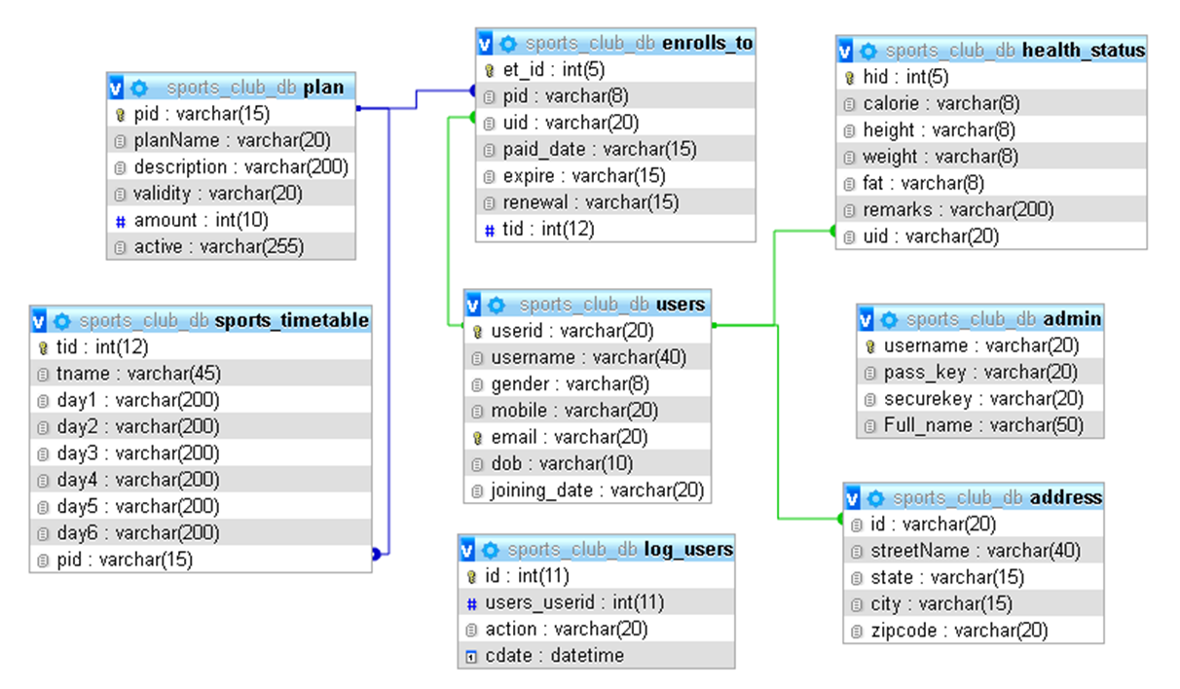
SCHEMA DIAGRAM

Slide 5
NORMALIZATION
Database Normalization is a technique of organizing the data in the database. Normalization is a systematic approach of decomposing tables to eliminate data redundancy(repetition) and undesirable characteristics like Insertion, Update and Deletion Anomalies. It is a multi-step process that puts data into tabular form, removing duplicated data from the relation tables.
Normalization is used for mainly two purposes :
Eliminating redundant(useless) data.
Ensuring data dependencies make sense i.e data is logically stored.

Slide 6
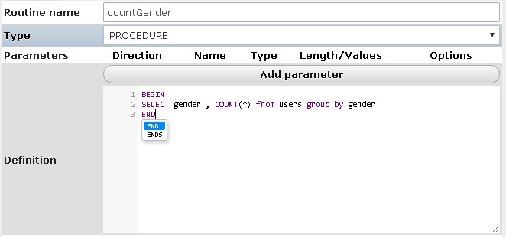
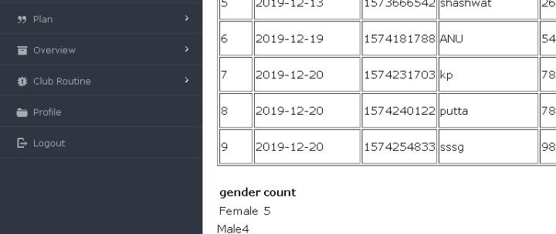
STORED PROCEDURE
A procedure (often called a stored procedure) is a subroutine like a subprogram in a regular computing language, stored in database. A procedure has a name, a parameter list, and SQL statement(s). All most all relational database system supports stored procedure

Slide 7
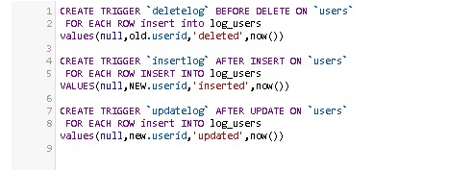
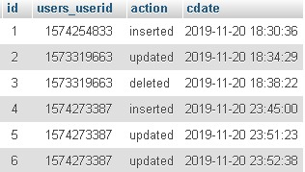
TRIGGERS
A trigger is a set of actions that are run automatically when a specified change operation (SQL INSERT, UPDATE, or DELETE statement) is performed on a specified table. Triggers are useful for tasks such as enforcing business rules, validating input data, and keeping an audit trail.

Slide 8
HARDWARE & SOFTWARE
Hardware Interface:
Hardware requirements for running this project are as follows :
Processor: - Pentium I or above.
RAM: - 128 MB or above.
HD: - 20 GB or above.
Software Interface:-
Software required to make working of product is :
Front end- PHP
Back end- MySql
Server - XAMPP

Slide 9
CONCLUSION
After implementing the application it will contain the advantages that are incomparable to the present contemporary systems used by company. The most admirable feature founded was its simplicity in terms of application to the user but its highly beneficial outputs can’t be ignored. The users will be highly benefited after using the system.
It is hoped that this project will help the future developers to modify and implement the system. After modifying some techniques of the programs, it will give us the best performance as our requirements. The project will be very useful for the users.

Slide 10
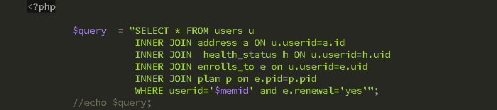
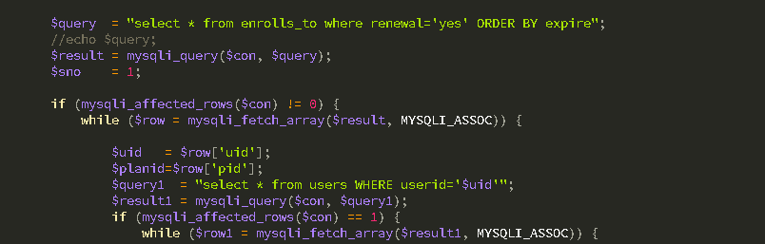
QUERIES

Slide 11
